Slide 1
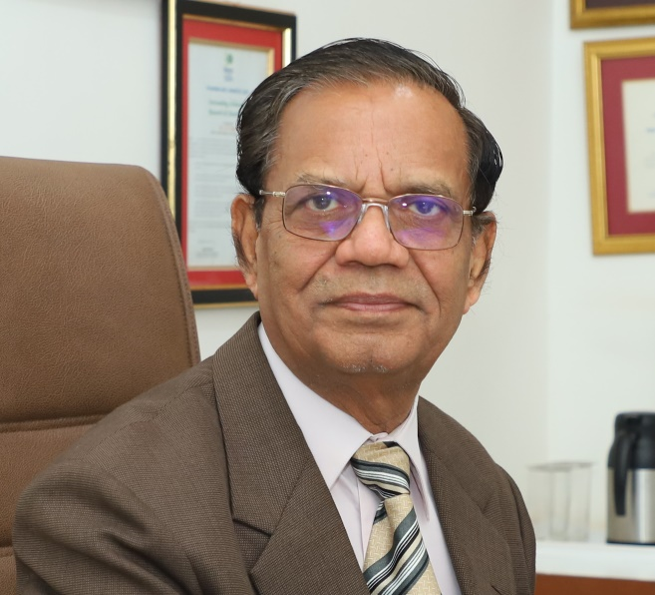
A proud Moment…
Stanford University, USA
Mentions Provost Dr. J. S. Yadav in the list of top 2% of Scientists Worldwide in 2020
Recognition in the categories of:
- Organic Chemistry (India - Rank 1; World - Rank 211 out of 1,44,918)
DR. J.S. YADAV PROVOST & DIRECTOR (RESEARCH), INDRASHIL UNIVERSITY
CRSI ( Chemical Research Society of India) confers Gold Medal, 2022 for Life-time Achievement in Chemical Research

